Slide 1
IMAD PRACTICUM

Slide 2
agenda
INTRODUCTION 3
WELCOME PAGE DESIGN 4
ENGAGING THE AUDIENCE 5
VISUAL AIDS 6
FINAL TIPS & TAKEAWAYS 11

Slide 3
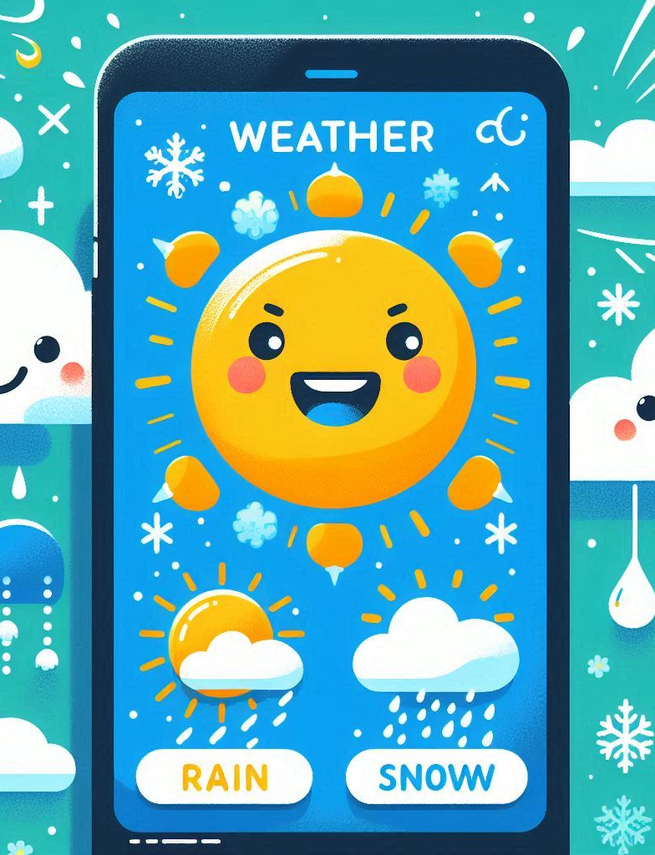
the power of whether and technology.
Convenience: Weather apps provide easy access to up-to-date forecasts and weather conditions at your fingertips
Planning: They enable better daily
Safety: With timely alerts and severe weather warnings, these apps can help you stay safe
Health: Some weather apps also offer insights into air quality and UV exposure.

Slide 4
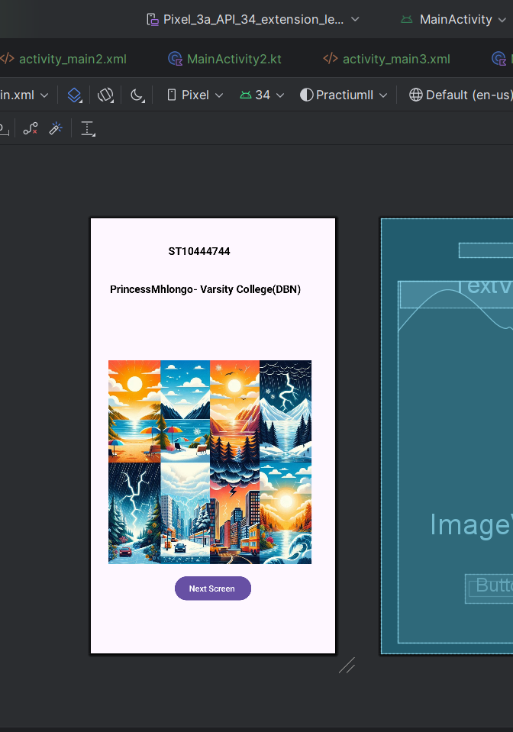
Welcome page ( splash screen)
This first screen is where the user knows the creator of the app by name and from which institution they are enrolled.
clear background
1 button which will take you to the next screen
1 picture which consisted of 8 different pictures(picmix or collage) Inshot was used to merge the pictures.
2 text views for student number and name.

Slide 5
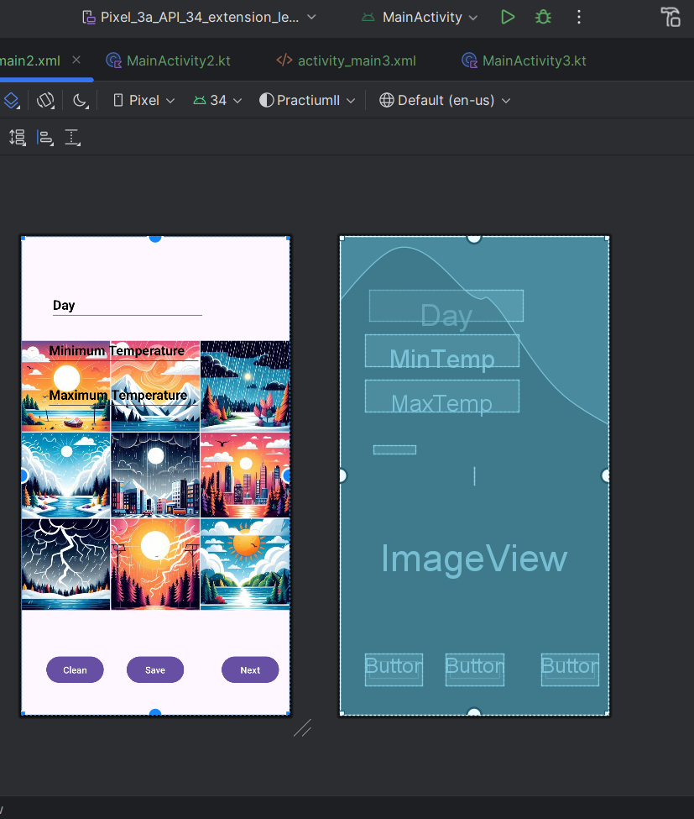
Screen 2( Screen 1 of the actual app)
After clicking the button, you are then taken to the next page where you will find :
4 text views
An image (the same technique used liked the above)
3 buttons ( clean, save, and next)

Slide 6
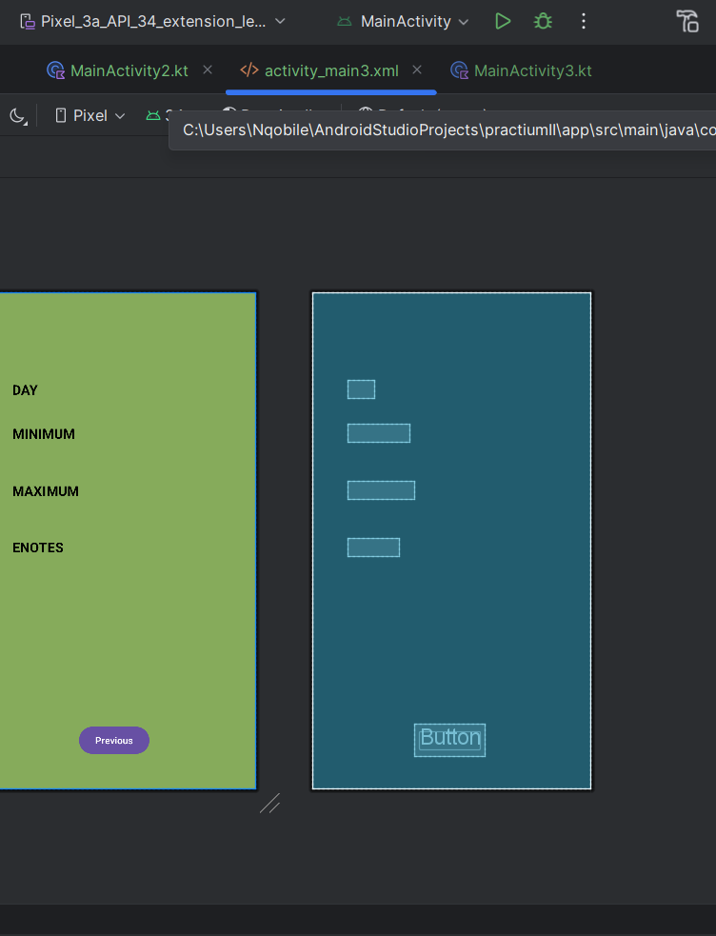
Screen 3( second screen of the actual app)
This is the final screen which reports to the user the necessary information. It contains the following:
4 texts
A button( which allows you to go back to the previous screen)
Background , I decided to keep it elegant with a olive green background

Slide 7
Engaging to the audience.
Able to know the day's minimum, average, and maximum temperature.
Fast effective and easy-to-use app!
Provide thoughtful responses if there was an error while using.

Slide 8
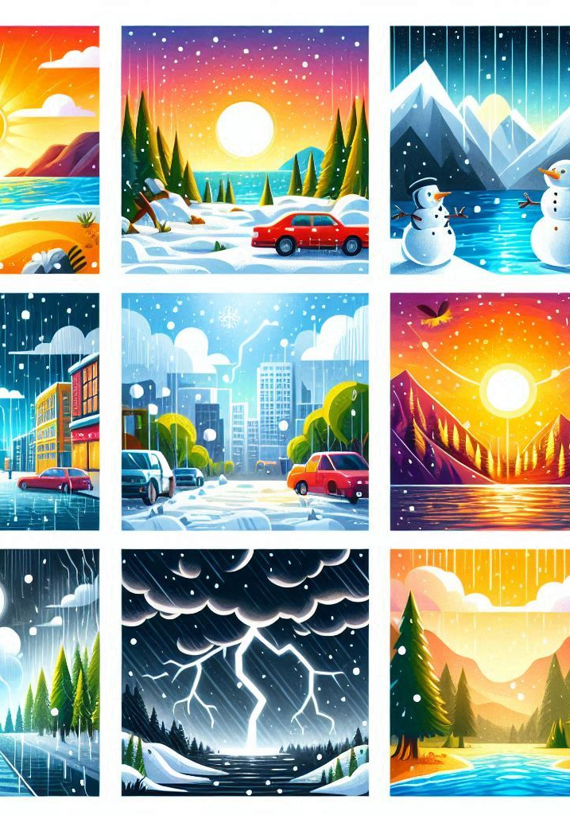
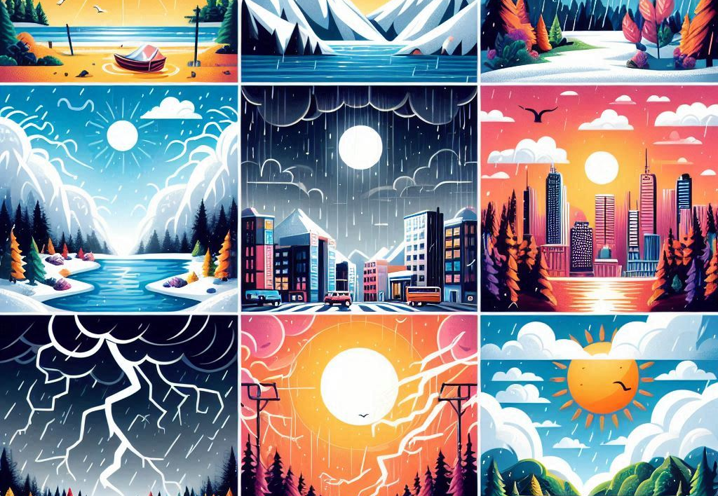

selecting visual aids that had been used to make this app a success.

Slide 9

Pseudocode in Kotlin.
PROGRAM MainActivity
DECLARE textview AS TextView
DECLARE button AS Button
DECLARE imageView AS ImageView
FUNCTION onCreate(savedInstanceState AS Bundle)
CALL super.onCreate(savedInstanceState)
CALL enableEdgeToEdge()
SET setContentView TO R.layout.activity_main
SET textview TO findViewById(R.id.Details)
SET button TO findViewById(R.id.buttonNextScreen)
SET imageView TO findViewById(R.id.imageView)
SET button.OnClickListener TO
FUNCTION onClick()
DECLARE intent AS Intent
SET intent TO Intent(CurrentActivity, MainActivity2)
CALL startActivity(intent)
END FUNCTION
END FUNCTION
END PROGRAM

Slide 10
speaking engagement metrics
DAY | WEATHER CONDITION | MINIMUM TEMP | MAXIMUM TEMP
MONDAY | SUNNY | 12 | 25
TUESDAY | SUNNY | 15 | 29
WEDNESDAY | CLEAR SKYIES | 14 | 26
THURSDAY | PARTLY COULDY | 11 | 23
FRIDAY SATURDAY SUNDAY | WINDY RAINING COLD | 12 10 10 | 21 18 16

Slide 11
thank you.
ST10444744
Princess mhlongo
princessantonionqobilemhlongo@gmail.com
princessnqobilemhlongo@gmail.com

